Slide 1
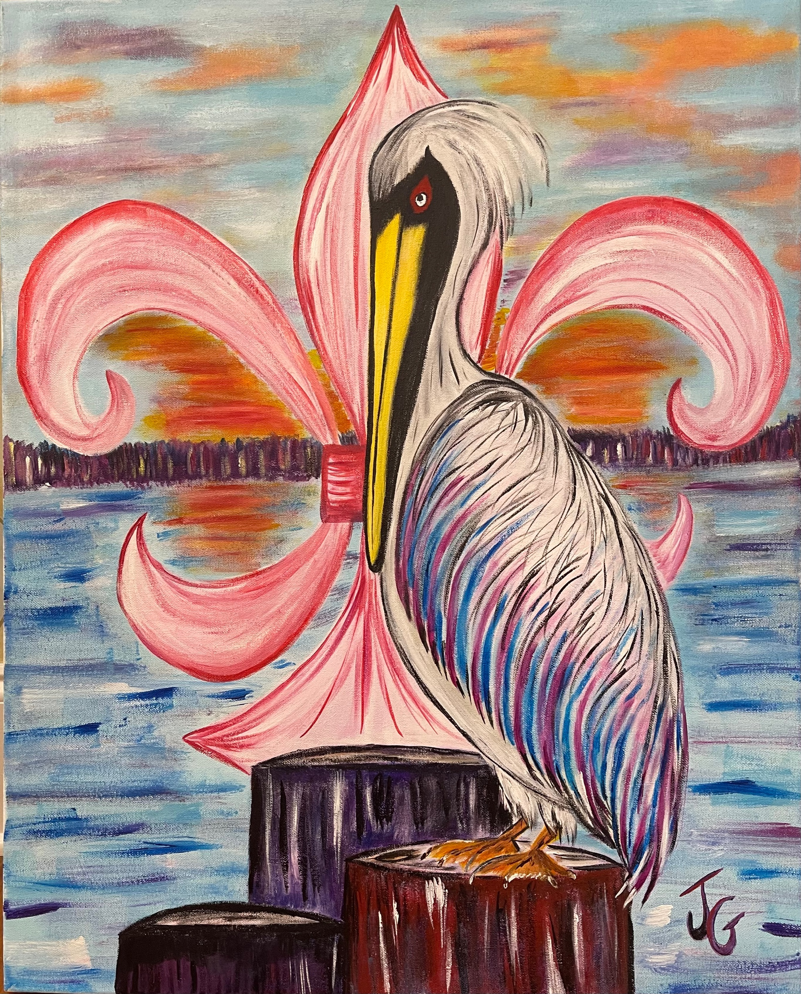


9th Annual
“Fishing For The Girls Rodeo”
Myrtle Grove Marina
October 23rd & 24th 2026
Registration:
$25 Per Person
Free for Children (Under 12)
Rodeo Fishing Shirts and Hats available
at event
Event Schedule
Friday Oct 23rd: Myrtle Grove Marina
Fishing begins @ daylight
4pm-5:30pm (Sharp): Weigh-In (must be registered)
6PM Myrtle Grove Marina
Pink Party
Live music, food, BYOL,
Rodeo registration
Saturday Oct 24th:
Fishing begins @ daylight
12pm-3pm(sharp): Weigh-In
1pm-6pm: Will Isemann Live,
Prizes and Live Auction
Food & Soft Drinks (free)
(Beer & Alcohol will be Sold)
Kid Zone with Games & Prizes
6 pm: Memorial Silent Prayer
Sponsorship Opportunities
Email us for a Sponsorship Form
PINK Sponsorship: $1000
Gold Sponsor: $ 500
Silver Sponsor: $ 300
Bronze Sponsor: $ 100
Artist: Jeannine Gondrella
Fishing Categories
Adults:
Red Fish (18”- 27”), Speckled Trout , Drum, Biggest Non-Category Fish
**FLOUNDER ARE OUT OF SEASON**
Children: (Under 12)
Red (18”-27”), Speckled Trout,
Catfish (any kind)
Benefiting West Jefferson Hospital Breast
Cancer Center & other breast cancer
support groups
Register
Donate
Sponsor
Kids bank Fishing & Games
Saturday 10/24/26
Scan me
Sponsored by Fishing for Charities, Inc., a Louisiana non-profit Corporation.
A Federal 501c3, Public Charity entity which entitles donor to deduct donation from Federal taxes.
TAX ID # 81-3366775
Visit http://www.fishing4charities.com

Slide 2

^{9th} Annual
“Fishing For The Girls Rodeo”
Myrtle Grove, Louisiana
October 23rd & 24th 2026
Sponsorship Opportunities
Name: ____________________________________ Phone _________________________
Address: ____________________________________________________________________
Email: ____________________________________________________________________
PINK Sponsorship: $1000
Receive 10 rodeo tickets, 10 fishing towels, your logo on our website and your organization's logo on the banner at Saturday afternoon’s celebration.
Gold Sponsor: $ 500
Receive 5 rodeo tickets, 5 fishing towels, your logo on our website and your organization's logo on the banner at Saturday afternoon’s celebration.
Silver Sponsor: $ 300
Receive 3 rodeo tickets, 3 fishing towels, your logo on our website and your organization's logo on the banner at Saturday afternoon’s celebration.
Bronze Sponsor: $ 100
Receive 2 rodeo tickets and 2 fishing towels, and your name on our website.
I will pick up tickets and fishing towels/drawstring totes (please circle): At the rodeo Mail them
In-Kind donations are very important and are needed as door prizes, silent auction items, food, and other essentials.
Please email Mark Bergeron for a sponsor package at fishing4charities@gmail.com or print and return this form with your sponsor check payable to:
Fishing for Charities, Inc
104 Pleasant Ridge Dr.
Belle Chase, LA 70037
Reeling in a Cure
Sponsored by Fishing for Charities, Inc., a Louisiana non-profit Corporation. A Federal 501c3, Public Charity entity which entitles donor to deduct all donations from Federal taxes. TAX ID # 81-3366775
Scan me

